Slide 1


Symbiosis Institute of Technology, Nagpur
PREDICTIVE ANALYTICS • POWER BI • MACHINE LEARNING
Customer Churn Prediction
for a Telecom Company
From descriptive dashboards to machine-learning-based risk scoring — identifying WHAT is happening, WHY it happens, and WHO is likely to churn.
Business Intelligence | 7th Semester
Presented by Mukund Kuthe & Ravi Kumar Kushwaha
PRN: 23070521082, 23070521116
Institute Guide: Dr. Dharmaveer Chaudhary

Slide 2

PROBLEM STATEMENT
The Business Problem
Telecom is a subscription business — revenue depends on keeping customers, not just acquiring them. Yet a large share of subscribers cancel their service every year, and without a systematic way to spot who is leaving and why, retention teams are left reacting after the fact instead of intervening in time.
DATASET
Telco Customer Churn Dataset
THIS PROJECT AIMS TO:
Publicly available on Kaggle, containing customer demographics, account information, subscribed services and churn status.
Analyze historical customer data to uncover patterns behind churn
Identify the contract types, services and pricing linked to higher risk
7,043
Build a machine-learning model that predicts which customers are likely to leave
Customer records
21
Translate those predictions into a risk-ranked list retention teams can act on
Attributes per customer
kaggle.com/datasets/blastchar/
telco-customer-churn/data
Customer Churn Prediction — Telecom
2

Slide 3



PROJECT JOURNEY
One Dataset, Three Questions
The project follows a descriptive → diagnostic → predictive analytics journey across three linked Power BI dashboards.
DASHBOARD 1
DASHBOARD 2
DASHBOARD 3
What is happening?
Why is it happening?
Who will churn next?
Executive Overview — overall churn scale, churn by contract, internet service and payment method.
Customer & Service Analysis — tenure, monthly charges, tech support and demographic drivers of churn.
ML Prediction & Risk — a KNN classification model scores 1,407 customers by churn probability and risk tier.
Customer Churn Prediction — Telecom
3

Slide 4
BUSINESS CONTEXT
Why Churn Matters for This Telecom
Acquiring a new subscriber costs far more than retaining one. With over 1 in 4 customers churning, even small, well-targeted retention actions translate into meaningful revenue protection.
PROJECT AT A GLANCE
7,043
Total customers analysed
Quantify the current scale and shape of customer churn
26.54%
Diagnose the behavioural and service factors driving it
Overall churn rate
Predict which active customers are most likely to leave next
1,407
Equip retention teams with a risk-ranked customer list
Customers scored by ML model
76.19%
Best model (KNN) accuracy
Customer Churn Prediction — Telecom
4

Slide 5

METHODOLOGY
From Raw Data to a Live Dashboard
1. Prepare in Python
2. Model in Power BI
3. Predict with ML
4. Visualize in 3 Pages
The Telco Customer Churn dataset (7,032 customers) was cleaned in Python: columns standardized, TotalCharges converted to numeric, and the data split into four purpose-built tables, including a separate 1,407-row ML scoring set.
Files were connected via a single Folder query (not Combine), preserving each table's structure. Text columns were trimmed/cleaned, data types verified, and customerID relationships built between Customer_Details, Customer_Services and Churn_Analysis.
Five classification models — Logistic Regression, KNN, Decision Tree, Random Forest and SVM — were compared on Accuracy, Precision, Recall, F1 and ROC-AUC. K-Nearest Neighbors was selected as the best-performing model.
Results were delivered as three linked report pages — Executive Overview, Customer & Service Analysis, and ML Prediction & Risk — each answering a progressively deeper business question.
→
→
→
Customer Churn Prediction — Telecom
5

Slide 6
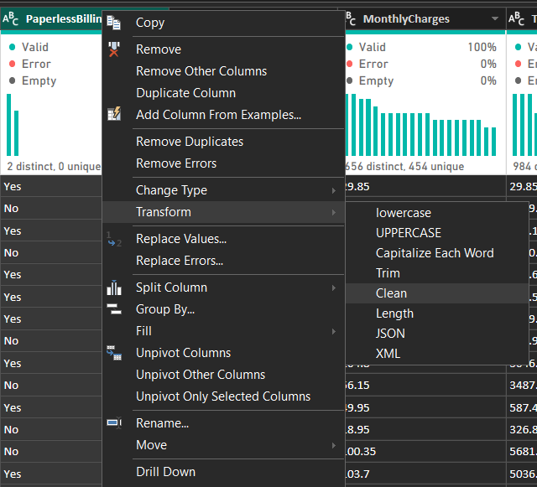
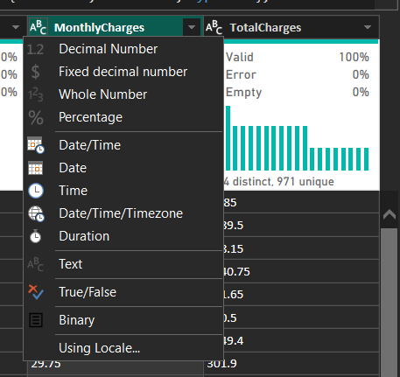
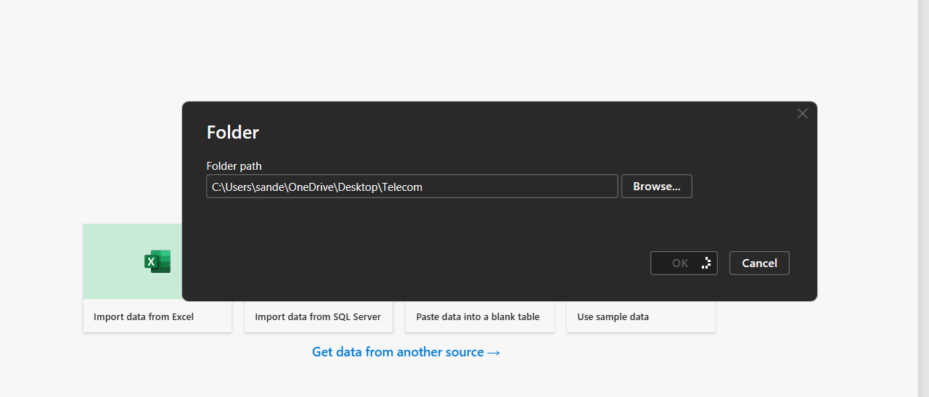
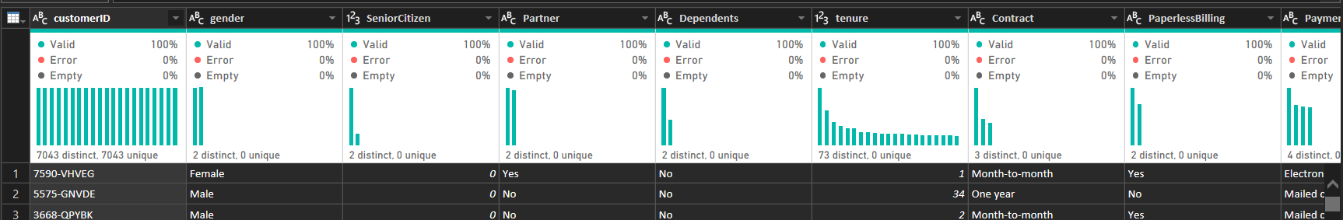
DATA PREPARATION
Data Transformation in Power Query
Before modelling, every table was connected, profiled and cleaned inside Power Query — screenshots below are from the actual project file.
1. Connect the source folder
2. Profile every column
3. Clean text columns
4. Fix data types
Get Data → Folder → Transform Data. Files are kept as separate queries rather than combined, since each CSV has a different structure.
Column quality, distribution and profile views (on the entire dataset) surface missing values, errors and duplicate/invalid entries.
Transform → Format → Trim, then Clean, is applied to categorical columns to strip stray spaces and non-printing characters.
Numeric fields (tenure, MonthlyCharges, TotalCharges) are set to Whole Number / Decimal; categorical columns are kept as Text.
Screenshots captured from the project's own Power BI / Power Query session.
Customer Churn Prediction — Telecom
6

Slide 7
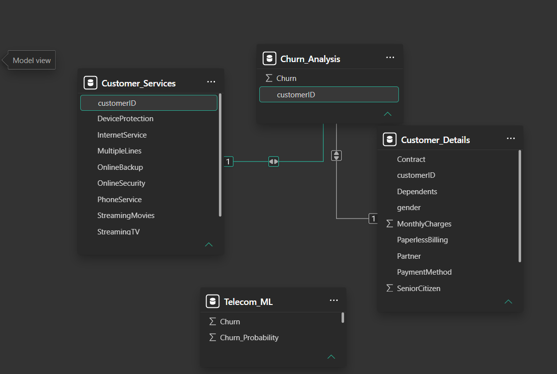
DATA ARCHITECTURE
A Clean, Relational Data Model
Four tables connect through a single key — customerID — keeping demographic, service, churn-outcome and ML-prediction data cleanly separated yet fully queryable.
1
Customer_Details
Demographics, contract, billing (7,032 rows)
2
Customer_Services
Phone, internet & add-on services
3
Churn_Analysis
Actual churn outcome (0 / 1)
Actual Power BI Model View — relationships built on customerID
4
Telecom_ML
1,407-row KNN prediction & probability set
Customer Churn Prediction — Telecom
7

Slide 8
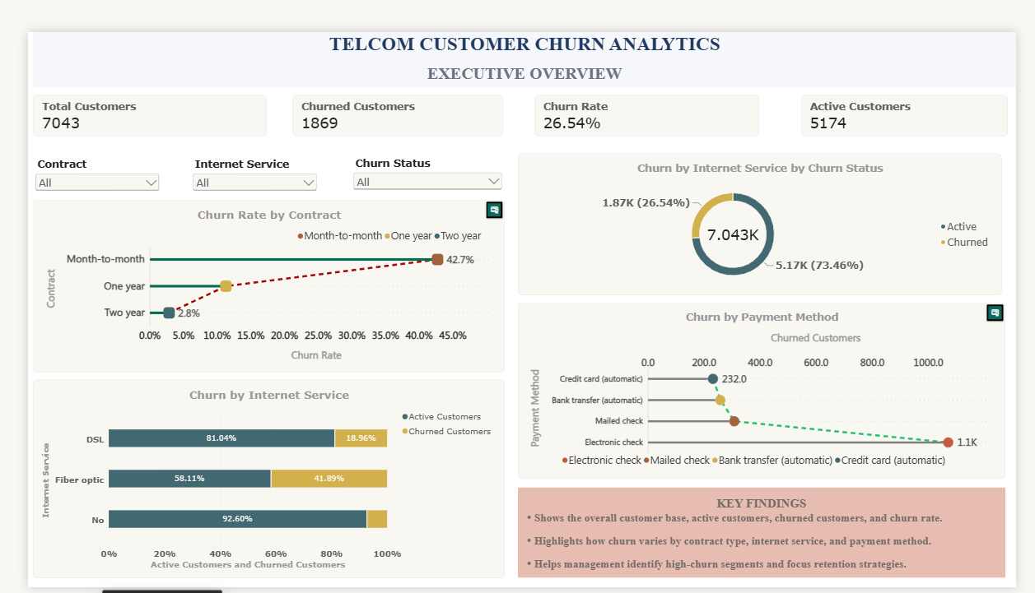
DASHBOARD 1 — DESCRIPTIVE
Executive Overview
Answering: what is happening with customer churn?
7,043
1,869
26.54%
5,174
KEY INSIGHTS
Total customers
Churned customers
Churn rate
Active customers
Month-to-month customers churn at 42.7% — far above 1-year and 2-year contracts.
Fiber Optic subscribers show the highest churn share of any internet service, at 41.89%.
Electronic check is the payment method most associated with churned customers.
Churn is concentrated, not evenly spread — pointing to clear priority segments.
Actual Power BI report page (screenshot)
Customer Churn Prediction — Telecom
8

Slide 9
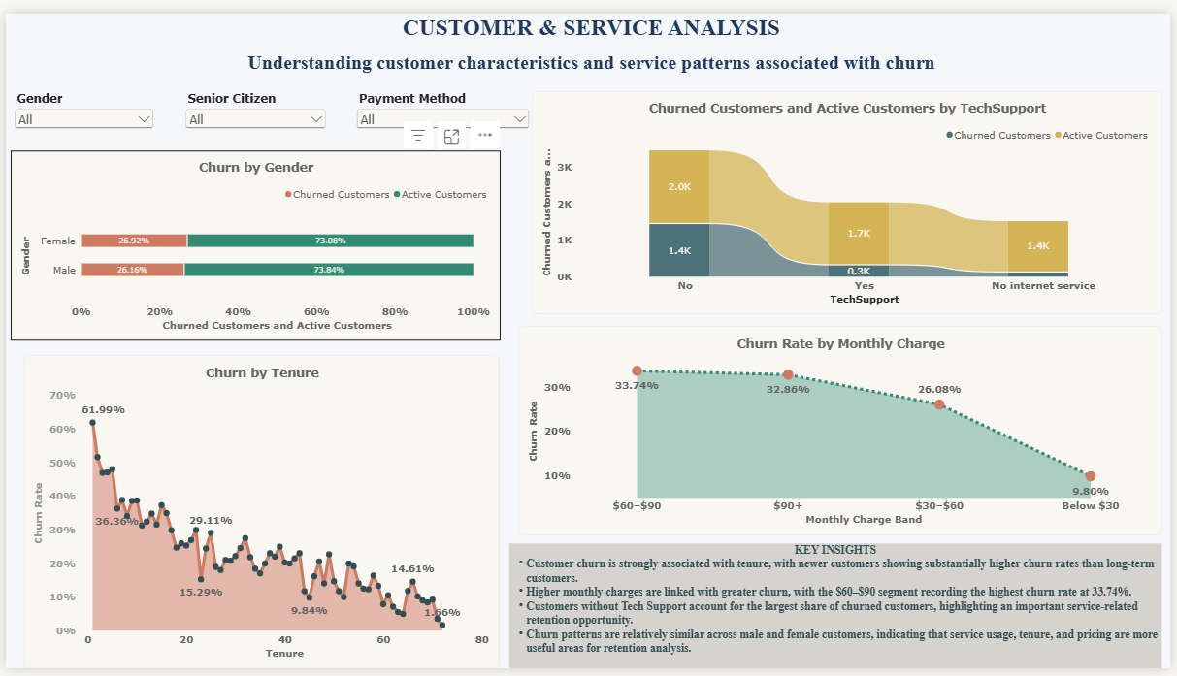
DASHBOARD 2 — DIAGNOSTIC
Customer & Service Analysis
Answering: what factors are associated with churn?
26.9%
26.2%
62%
33.7%
KEY INSIGHTS
Female churn rate
Male churn rate
Churn in month 1 tenure
Churn, $60–$90 charges
Gender shows almost no difference in churn — not a meaningful driver.
Customers without Tech Support make up the largest churned group by far.
Churn is highest for brand-new customers and falls steadily as tenure grows.
Higher monthly charges ($60–$90+) correlate with sharply higher churn rates.
Actual Power BI report page (screenshot)
Customer Churn Prediction — Telecom
9

Slide 10
PREDICTIVE MODELLING
Choosing the Right Classification Model
Five algorithms were trained and compared on the same customer features — the winner was chosen on balanced performance, not accuracy alone.
Logistic
Regression
K-Nearest
Neighbors
Decision
Tree
Random
Forest
Support Vector
Machine (SVM)
SELECTED
Evaluated on: Accuracy · Precision · Recall · F1-Score · ROC-AUC
KNN MODEL PERFORMANCE
76.19%
54.96%
57.75%
56.32%
78.59%
Accuracy
Precision
Recall
F1-Score
ROC-AUC
Customer Churn Prediction — Telecom
10

Slide 11
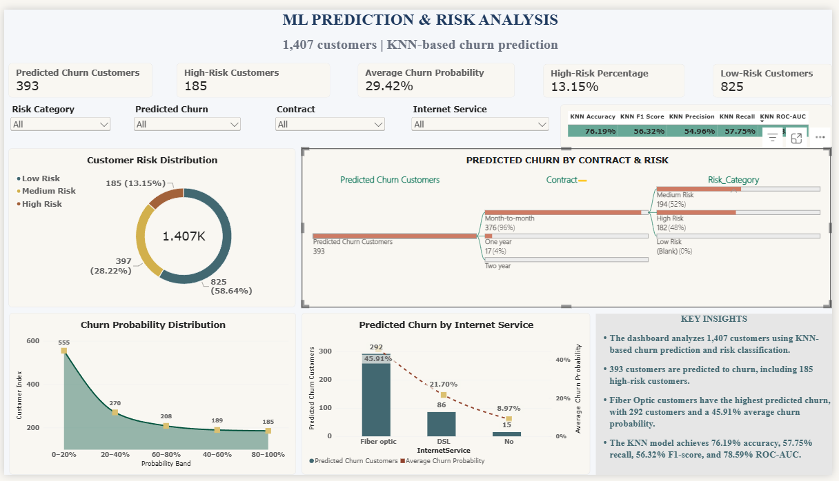
DASHBOARD 3 — PREDICTIVE
ML Prediction & Risk Analysis
Answering: who is likely to churn next? (KNN model, 1,407 customers)
393
185
29.42%
76.19%
KEY INSIGHTS
Predicted to churn
High-risk customers
Avg. churn probability
Model accuracy
96% of predicted churners are on month-to-month contracts — the #1 retention target.
Fiber Optic customers have the highest predicted churn: 292 customers at 45.91% avg. probability.
185 customers (13.15%) are flagged high-risk and warrant immediate outreach.
58.64% of the base is low-risk — retention spend can be focused, not broad.
Actual Power BI report page (screenshot)
Customer Churn Prediction — Telecom
11

Slide 12

SYNTHESIS
What We Learned, End to End
SCALE
26.54% of customers have churned — a material, recurring revenue loss.
SEGMENT
Month-to-month contracts, Fiber Optic service and no Tech Support consistently over-index on churn.
LIFECYCLE
Risk is front-loaded: new customers churn far more than long-tenured ones, and higher bills raise risk further.
PREDICTION
A KNN model (76.19% accuracy, 78.59% ROC-AUC) identifies 393 likely churners, 185 of them high-risk.
Customer Churn Prediction — Telecom
12

Slide 13



RECOMMENDATIONS
Turning Insight into Retention Action
Prioritize the 185 high-risk customers
Incentivize contract upgrades
Route the ML-flagged high-risk list to retention teams for proactive, personalized outreach this quarter.
Offer targeted discounts or perks to move month-to-month customers onto 1- or 2-year plans, where churn drops to 2.8%.
Bundle Tech Support proactively
Watch the first 90 days closely
Promote or bundle Tech Support with Fiber Optic plans — both are strongly linked to higher churn when absent.
Build an early-tenure onboarding and check-in program, since churn risk is highest in customers' first months.
Customer Churn Prediction — Telecom
13

Slide 14
Thank You
Customer Churn Prediction for a Telecom Company
Descriptive dashboards + a KNN predictive model, working together to tell retention teams what is happening, why, and who to call next.

